Slide 1
Monopoly
Case Study

Slide 2
Breaking up Monopolist Case of AT&T
From 1913 until 1982, AT&T had a monopoly on the delivery of telephone services. As the years passed, however it became progressively harder for AT&T to defend its position that having a single provider of phone services was good for consumers. By the early 1980s AT&T was spending over 300 $million to fend of anti trusts suits from states, the federal government and many private firms. The AT&T monopoly ended in 1982,when enormous pressure from the government led the company to split into eight smaller companies. Suddenly AT&T had to compete to survive. The newly competitive market forced each of the phone companies to expand the services it offered and sometimes even lower its prices to avoid customers. For example rates on long distance calls which were quite high before the break up plummeted.

Slide 3
Reducing Trade Barriers: INDIAN AVIATION INDUSTRY
Reducing trade barriers creates more competition, lessens the influence of monopoly and promotes efficient use of resources. For example prior to 1994 private air carriers accounted for 0.5% of the air traffic in India. In 1994 Indian air space was opened to allow private airlines to operate scheduled service. This move forced the state owned Air India to become more competitive. These changes in Indian Aviation policies had the effect of raising the share of private airline operators in domestic passenger carriage to over 70% by 2012. Two private companies, Jet Airways and Indigo are now the largest carriers in India, while Air India which once controlled the market has slipped to third place.

Slide 4
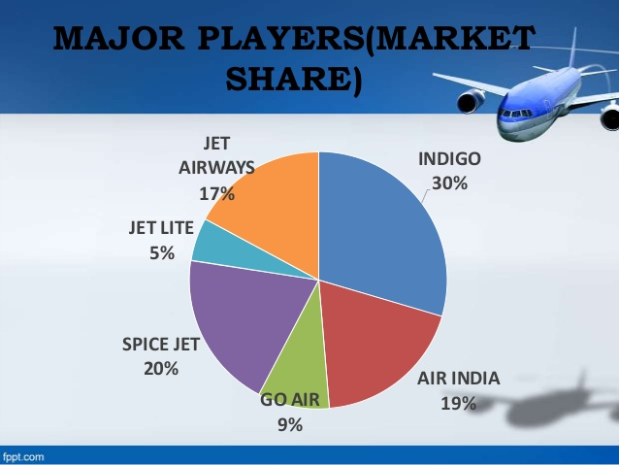
Indian Aviation Industry-Market share

